Slide 1

Predicting Tax Assessed Property Value
Presented by
Anisha Joshi
Gabriella Sussman
Tax Assessed Home Value

Slide 2

Problem Setting
Property taxes are an important part of a local government’s revenue.
It helps pay for things like public schools, libraries, local government employees' salaries, parks and recreation, sanitation, sewer, police and fire protection, roads, and other local needs
It is crucial that local governments be able to increase the accuracy and fairness of assessing properties, while also increasing the efficiency in assessing properties’ value.
By utilizing Machine Learning Models, local government employees can enhance their judgement by comparing the properties’ assessment with the assessed value provided by the Models, allowing them to spend more time and resources on other value-added activities.
The overall result is a more objective, timely, accurate, and equitable property valuation, providing more confidence to both the local government and the taxpayers.

Slide 3


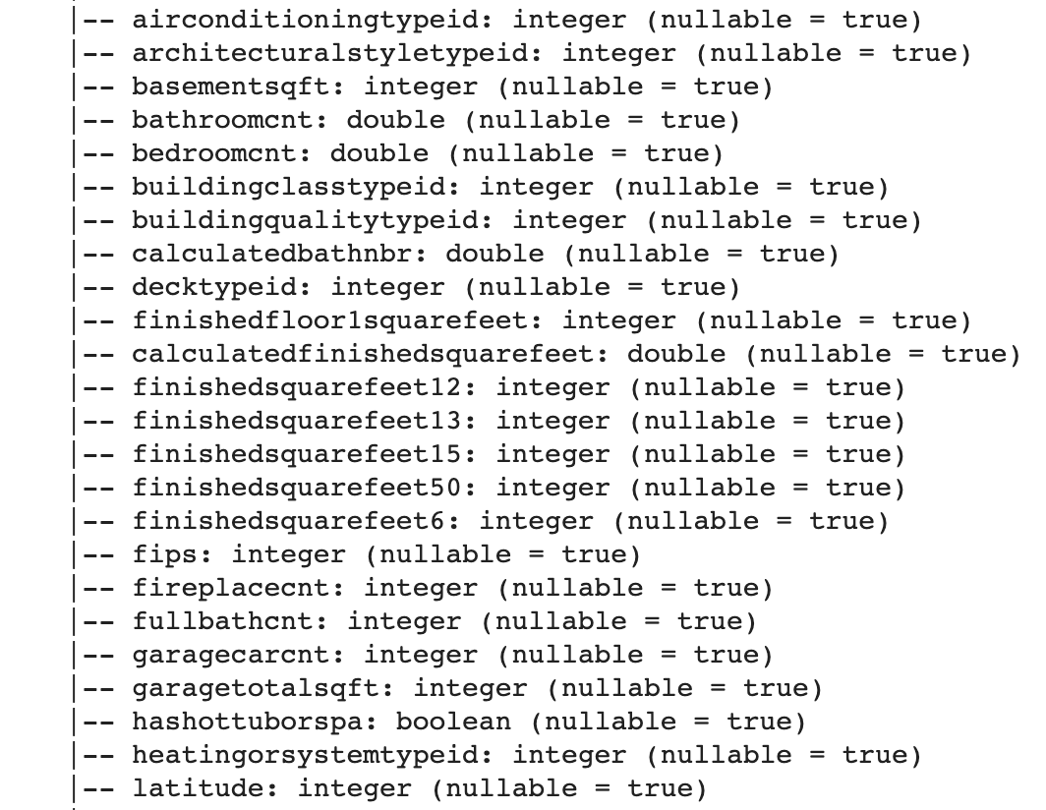

Dataset
Dependent Variable
“taxvaluedollarcnt” (The total tax assessed value of the parcel)
Zillow 2016 Property Data
3 California
counties
Independent Variables
From Kaggle
2.9M records with 58 feature columns
LA, Orange &
Ventura

Slide 4
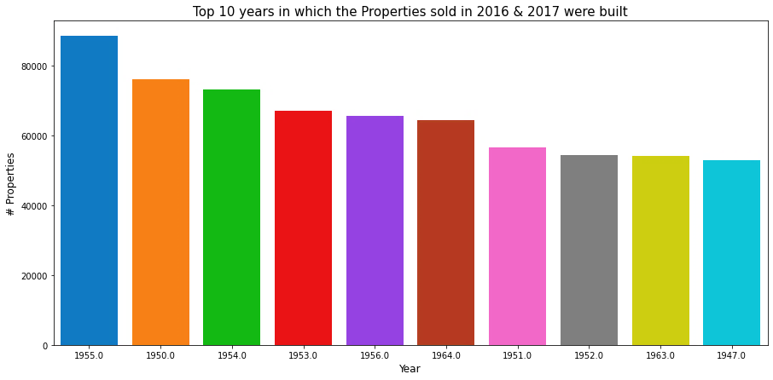
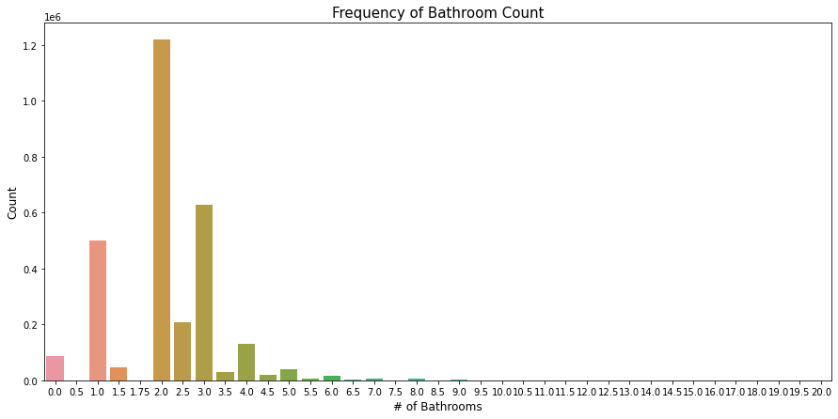
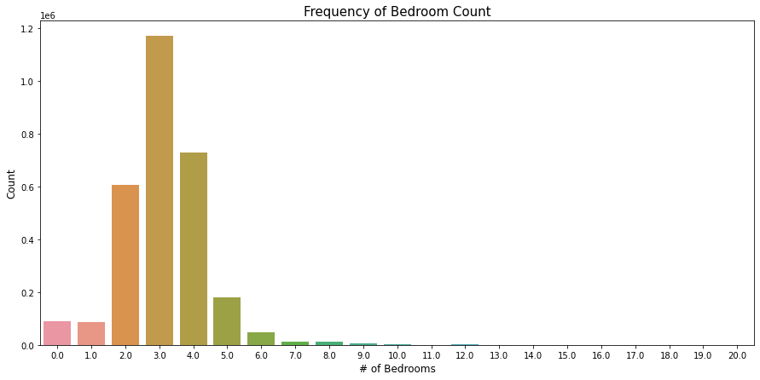
Data Exploration
Year Built (Top 10)
max bathroom count freq is 2
max bed count freq is 3

Slide 5
Data Cleaning
2.94 million rows
58 columns
2.94 million rows
34 columns
2.94 million rows
18 columns
Remove Columns with > 80% Missing Data
Remove Columns with High Correlation (> 0.8)
Remove Rows in Columns With < 10% Missing Data
Removed24 cols
Removed18 cols
Removed 0.25 mil rows
Correlation Matrix To Check Final Data & Columns
Convert Column Datatypes
Replacing Missing Values with 0
2.69 million rows
18 columns
2.69 million rows
18 columns
2.69 million rows
18 columns
Notes:
Missing data like garage count/parking/fireplace etc were replaced with 0 - we just could not take the mean or median values in this case

Slide 6

Data PreProcessing
Notes:
We normalize the values because the linear regression model needs the data to be normalized as this model is sensitive to non-normalized data.
Vector Assembler - to get vector of features and labels - The Vector Assembler converts the transformed features into a single feature column in order to train the machine learning model
Vector Indexer Automatically identifies categorical features, and index them.
Why normalize? Common scale.

Slide 7
Models
1.
2.
3.
4.
Decision Tree
DecisionTreeRegressor
Random Forest
RandomForestRegressor
Linear Regression
LinearRegression
Gradient Boosted Tree
GBTRegressor
Notes:
Used regression evaluator with metrics rmse and r2.

Slide 8

Model Evaluation Results
RMSE
R2 (R-Square)
Root mean squared error (RMSE) is the square root of the mean of the square of all of the error, and a smaller value indicates a smaller error between prediction and actual value. The use of RMSE is very common, and it is considered an excellent general-purpose error metric for numerical predictions.
R Square value is between 0 to 1 and a bigger value indicates a better fit between prediction and actual value. It is a good measure to determine how well the model fits the dependent variables.
Different Models
Different Models
82697
0.877
Decision Tree
Decision Tree
80512
0.884
Random Forest
Random Forest
199822
0.284
Linear Regression
Linear Regression
59718
0.936
Gradient Boosted
Tree
Gradient Boosted
Tree
Best Model: Gradient Boosted Tree (GBTRegressor)
Top 4 Important Features: buildingqualitytypeid, unitcnt, calculatedfinishedsquarefeet,
propertylandusetypeid
Notes:
Importance features using feature importance

Slide 9
Thank You

